Slide 1
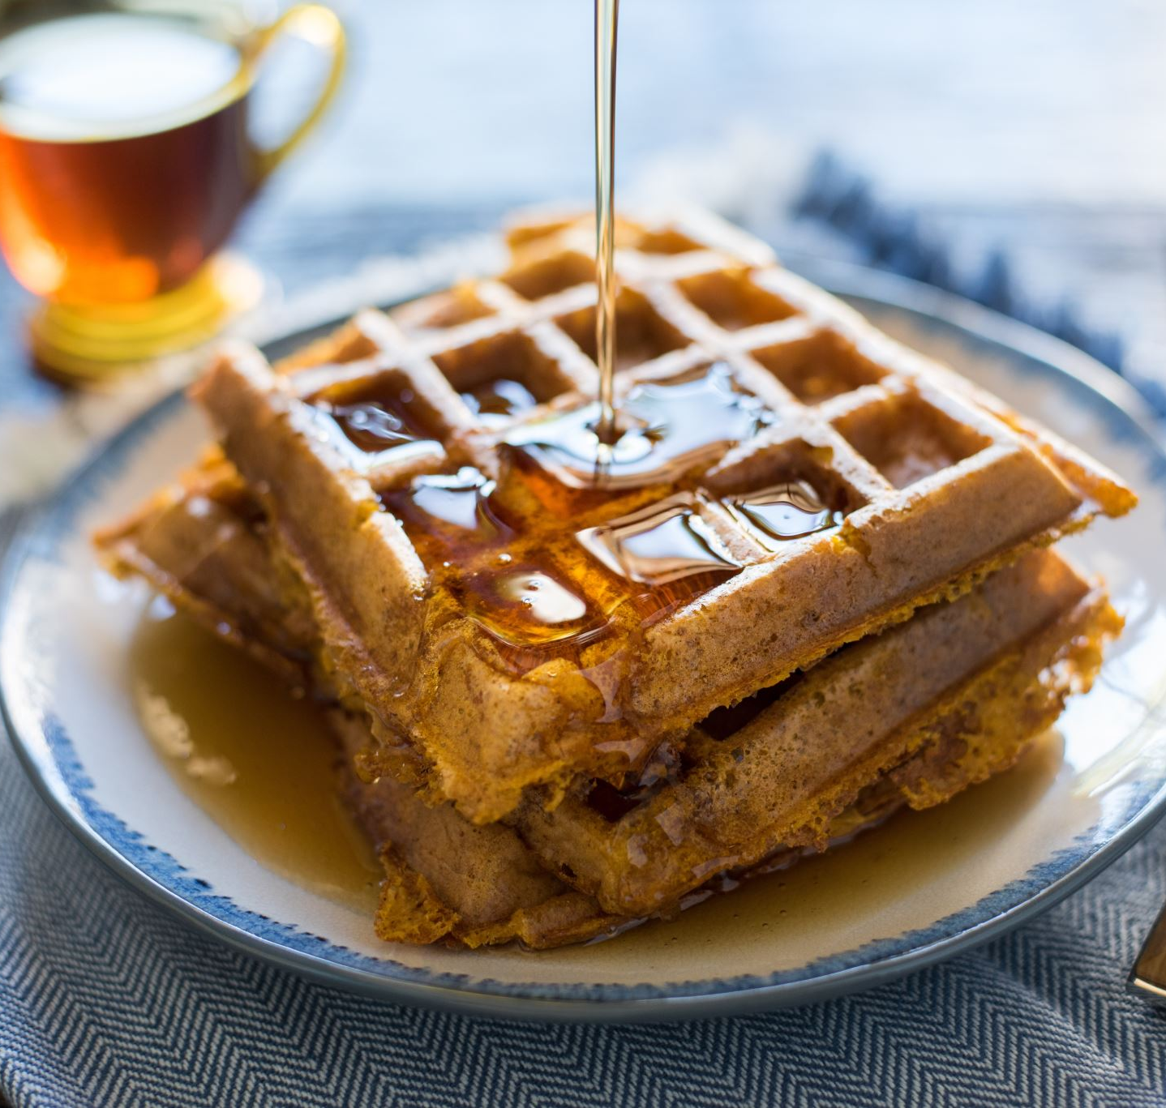
DATA 606 CAPSTONE PROJECT – Phase 3 SENTIMENT ANALYSIS ON YELP DATASET REVIEWS
ARJUN REDDY SEELAM
Spring 2021

Slide 2
Cat Boost Classifier
The name Cat Boost is derived from Category Boosting, which is open-sourced recently. It can work with a variety of data types to help companies solve a variety of problems.
Category means dealing with multiple data types like audio, text data, images including historic data. Since this library is built on the gradient boosting library, the name "Boost" comes from the gradient boosting machine learning algorithm.
Advantages:
Performance
Handling different categories of data.

Slide 3
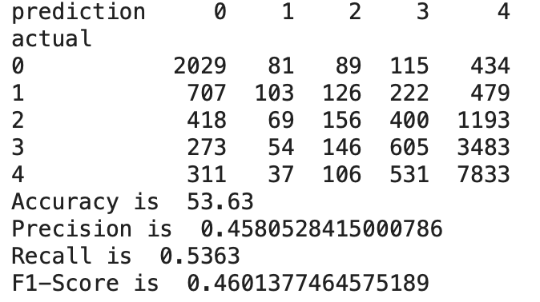
Results with Cat Boost
If we look at Actual vs Prediction cross tab obtained from test size of 20%, 7833 reviews were 5 - star rated reviews and, they are the predicted reviews.

Slide 4
Linear SVM model [Final Model]
Linear SVM is the new machine learning (data mining) algorithm for solving multi-class classification problems from extremely large data sets.
Advantages and features of Linear SVM:
It is efficient in dealing with larger datasets.
Linear SVM can work with thousands of features and attributes with large dataset.
Can be used in personal laptops with high computation speed.
Applying Text Classification: The method of categorizing text into ordered categories is known as text categorization. Text classifiers use Natural Language Processing (NLP) to automatically analyze text and assign pre-defined tags or categories based on its content.

Slide 5
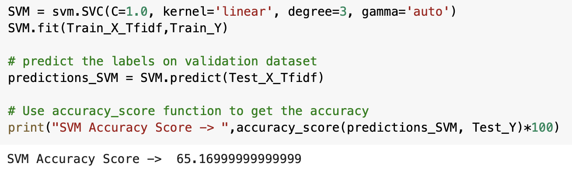
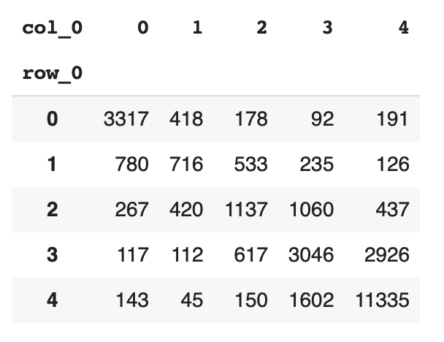
Applying Tf-Idf Vectorizer: To find the word frequencies, the most popular method is the IF-Idf method. With this vectorization, we set the maximum features to be extracted and perform linear modeling.
After applying vectorization and performing the model with Linear SVM, the accuracy on entire data is achieved as 65.17%.
We could observe the number of actual and predicted 5-star ratings are 11,335 which accounts for almost 40%.

Slide 6
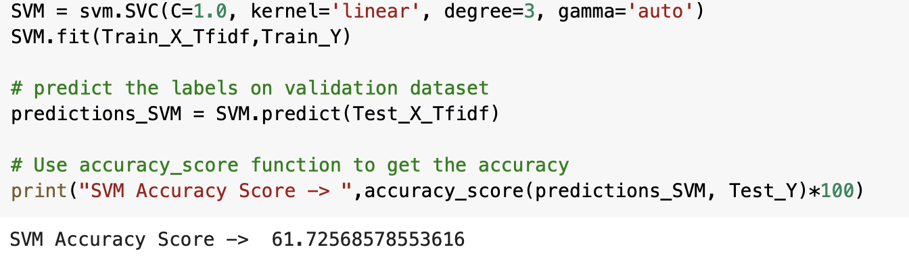
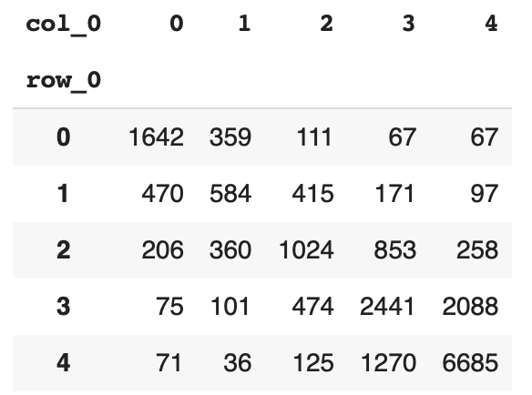
Applying Linear SVM to Restaurant Category data
Applying the same Linear SVM on restaurant data, the accuracy again decreased by 3% approximately when applied to whole data.
When we look at actual vs predicted table for restaurant category, from 20,050 reviews, the reviews which are 5-star and predicted correctly are 6685, which accounts for almost 34% of entire test dataset.

Slide 7
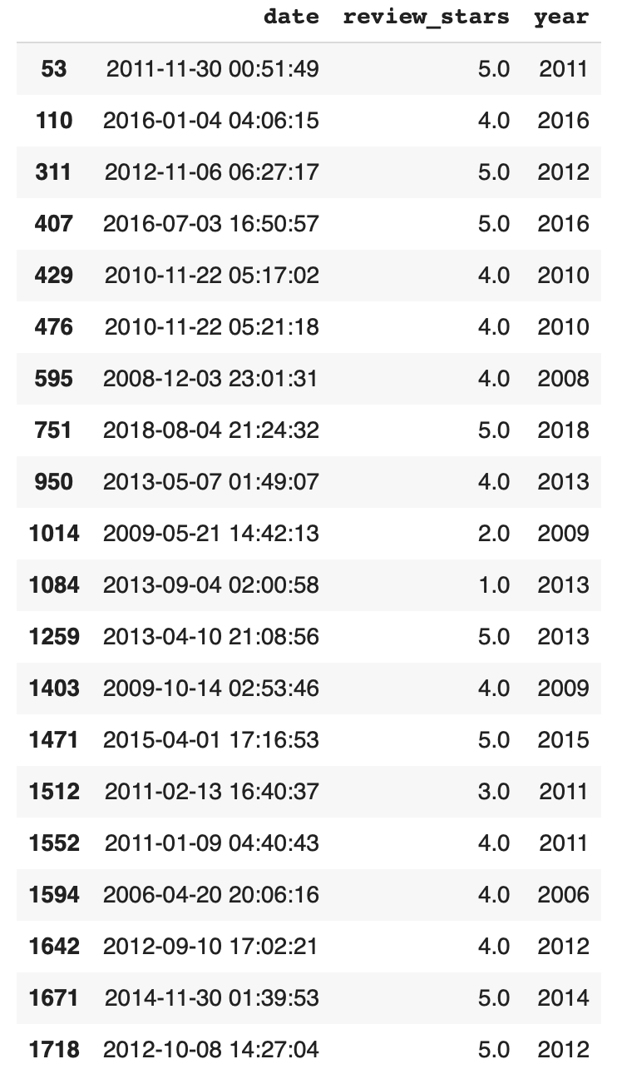
Research Question 1:
Is there any difference in improvement of ratings for a restaurant over the time based on negative review trend?
For a given business ID from the list of restaurants, the ratings of restaurant with business ID: rcaPajgKOJC2vo_l3xa42A are shown on left side. We could see there was a review with 2 star in 2009 and 1 star in 2013 but, overall, after 2009, there are more 5 - star and 4 - star ratings. So, there is a difference in improvement.

Slide 8
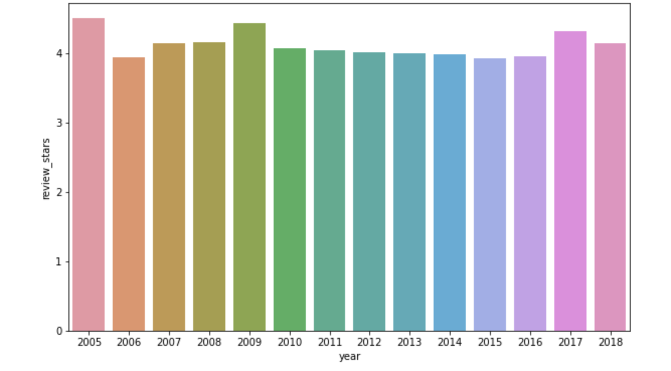
Research Question 2:
Did the restaurants really take the reviews into consideration to make changes in the business?
Yes, looking at the graph on the left side, we can clearly say that the restaurants have taken the reviews seriously to improve their business as the yearly trend is constant between 3.8 to 4.0 approximately.

Slide 9
Future Scope
Along with the ratings and reviews, location and zip code can also be considered to improve the accuracy based on location. As there is less scope to perform modelling on individual star ratings.
Perform various modelling techniques to improve the accuracy.
Build a neural network with 1D CNN on top of LSTM layer by using bidirectional recurrent layers to improve the accuracy.

Slide 10
References:
http://www.linearsvm.com/#:~:text=Linear%20SVM%20is%20the%20newest,a%20linear%20support%20vector%20machine.&text=Linear%20SVM%20is%20the%20newest,a%20linear%20support%20vector%20machine.
Khandelwal, P. (2020, March 27). Which algorithm takes the crown: Light GBM vs XGBOOST? Analytics Vidhya. https://www.analyticsvidhya.com/blog/2017/06/which-algorithm-takes-the-crown-light-gbm-vs-xgboost/

